Slide 1
Introduction to the power of policies
martin.cairney@rightjoin.net
Introduction to the power of policies
Adelaide SSUG – 25th January 2011

Slide 2
SQL Server 2008 Policy-Based Management
Central Management Servers
Extending with Windows PowerShell
Introduction

Slide 3
All SQL logins have password complexity rules enabled
All databases must be backed up every day
Ensure Compliance
Policy
Ensure Compliance
Enabled = True
Condition
LastBackupDate >= dateadd(‘day’, -1, getdate())
Login Options
Facet
Database Maintenance
SQL Server Policy-Based Management
Notes:
Start at the bottom of the slide.
A policy is based on a Facet. A facet is simply a logical group of properties that are related. For example an audit facet includes name, enabled. A server configuration facet includes all the settings available in sp_configure, including xp_cmdshell, MAXDOP.
Stored procedures have many aspects to them --- schema aspects, execution aspects, etc. Each is captured by a set of properties. Which do we care to say something about? ---- The schema properties. We call each set of properties a “management facet”.
What is a valid stored procedure? --- one where Name starts with “usp’. This is the Condition.
What do we want to do with this Condition ---- ensure complaince with it. This is the Policy. It tells the SQLServer management runtime to apply this intent.
So these are the basics of Policy-Based management. There is a management model of the system --- captured by the target types and facets. Management intent is captured by defining what an acceptable state of the system is ---- via a Condition. Finally, the Policy is the means to inform the management runtime services of what actual instances to apply the Condition to, when to apply it, and what to do if the Condition is violated. This is probably best explained interactively in the demo.

Slide 4
Policy Evaluation Modes
On Demand
On Schedule
On Change – Log Only
On Change – Prevent
SQL Server Policy-Based Management
Notes:
On Change – Prevent is the most restrictive as it is ony available on SQL Server 2008 and only for facets that can fire DDL triggers.
On Change – Log Only is also available on SQL Server 2008 only. Event notification evaluates a policy when a relevant change is made and records this in the SQL Server Error Log and the Windows Application Log.
On Schedule must be scheduled on a SQL Server 2008 instance as it relies on executing a PowerShell script. This is the core of the EPMF as the target instances can be on other servers and include downlevel versions.
On Demand is the least restrictive and can be used to evaluate any policy. It allows the policy to be executed by a number of means such as Management Studio (Object Explorer or CMS), PowerShell. It fully suppprts downlevel versions – obviously depending upon the properties exposed (for example using a policy to ensure databases have PageVerify = CHECKSUM would not be valid on a SQL 2000 instance).

Slide 5
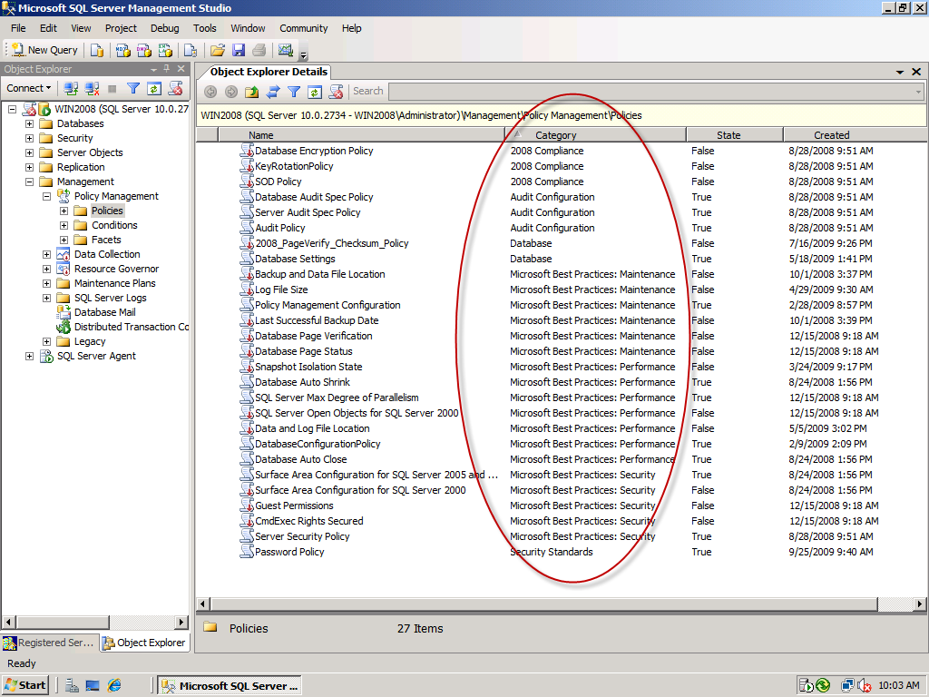
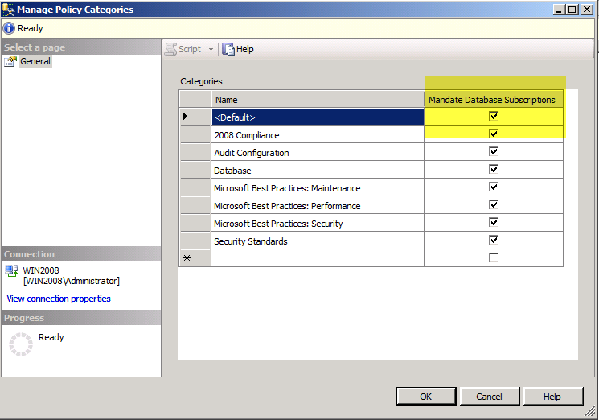
SQL Server Policy-Based Management
Notes:
We also want to ensure that we assign a Category to each of the policies that we create. This is especially important for the EPMF as we will see later on. Assigning categories helps to organise our policies and also manage policy evaluation.
<CLICK TO ADVANCE SLIDE>
For SQL Server 2008 instances where the policies are loaded locally, the policy category can be defined to MANDATE DATABASE SUBSCRIPTIONS. This impacts and controls whether an instance’s databases subscribe to this policy category. The alternate option for SQL 2008 allows individual databases to “opt-in” and can be therefore be used as an additional filter for the condition definition. Let’s have a quick look at how this works .....
<CLICK TO ADVANCE SLIDE>

Slide 6
Effect of Database Subscriptions
Target A
Security Category
AdventureWorks not subscribed
PayrollDB subscribed
(no pubs db)
Security Category
AdventureWorks subscribed
pubs subscribed
Target B
RTM
Target A: AdventureWorks evaluated
Target B: AdventureWorks and pubs evaluated
SP1 (+CU3)
Target A: PayrollDB evaluated
Target B: All databases checked
NO Security Category
AdventureWorks
Pubs
HRDB
SQL Server Policy-Based Management
Notes:
Here we have a Security Category defined on the source server. TARGET A also has the same Category defined locally but has different databases and subscriptions. TARGET B does not have the category defined locally.
The TARGET servers evaluate the policy from the source using their own Policy Engine. The category will define which databases the policy is evaluated against. In the RTM release of SQL 2008, the evaluation was based upon what databases are in the SOURCE subscription – i.e. The local subscription was ignored. However from CU3 of SP1, the behaviour has changed to now be dependant on the subscriptions on the instance being evaluated. Where the category doesn’t exist, all databases are evaluated. Be aware of the different results you get based upon your versions of SQL 2008.
We’ll show this in the demo now.

Slide 7
Central Management Server
extends Registered Server concept in SSMS
shared registrations for every user that connects to the same CMS
only works for instances in the same or a trusted domains
can register the same instance in multiple groups
registered servers stored in msdb in :
dbo.sysmanagement_shared_server_groups_internal
dbo.sysmanagement_shared_registered_servers_internal
Central Management Servers
Notes:
The next core component of the EPMF that we will look at is Central Management Servers.
NOTE that even though the registrations exist for everyone that can connect to the CMS, you still need to have a valid login for each and every instance defined to be able to connect to them yourself. The details are stored in msdb in the tables:
sysmanagement_shared_server_groups_internal
sysmanagement_shared_registered_servers_internal
NOTE that although I have selected to use the CMS approach, it will work just as well with an existing repository of servers\instance names that you have which we will see when we look at PowerShell.

Slide 8
DEMO
Policies and Central Management Servers
Notes:
Demo CMS and include how to execute policies against multiple instances.

Slide 9
Windows PowerShell
Notes:
Windows PowerShell is the core of the EPM Framework. It is built around the “Invoke-PolicyEvaluation” cmdlet included with the SQL Server 2008 installation of PowerShell.
We can pass in a set of policies to be evaluated at the –Policy parameter or pipe the selected policy objects into the cmdlet. The –TargetServer parameter identifies the instance against which the policies are evaluated. The target can be SQL Server 2008 or a down-level version and this is what allows us to build the EPM Framework to cover all instances in the enterprise.

Slide 10
Scaling to the Enterprise
Add Intelligence to Policies by placing each policy in a category and defining server restrictions for versions and editions where appropriate
Define Concurrent Jobs with parameters for each Policy Category and/or Central Management Server group
simple table structure in repository database so you can roll your own reports
Extend to the Enterprise

Slide 11
Enterprise Policy Management Framework
extends SQL Server 2008 Policy-Based Management to all versions of SQL Server in an enterprise
leverage CMS and Powershell script to capture the policy evaluation output and insert it into a SQL Server database
automate using SQL Agent job(s)
Reporting Services reports will deliver information from the centralised database
Summary

Slide 12
Issues Identified While Using Policy Management
some operational issues identified while creating Polices
documentation not always detailed – so you will experience a bit of trial and error
possible bugs raised at Connect website – please vote for these:
https://connect.microsoft.com/SQLServer/feedback/details/637291/policy-management-cannot-evaluate-policies-that-use-executesql-against-sql-server-2000
https://connect.microsoft.com/SQLServer/feedback/details/640369/executewql-in-policy-based-management-does-not-execute-against-some-facets
Summary

Slide 13
QL Server Manageability Team's blog on Policy Based Management
http://blogs.msdn.com/sqlpbm
Enterprise Policy Management Framework Download
http://epmframework.codeplex.com
Lara Rubbelke’s Blog
http://sqlblog.com/blogs/lara_rubbelke/default.aspx
Enterprise Policy Management Framework with SQL Server Whitepaper
http://sqlcat.com/whitepapers/archive/2009/02/25/enterprise-policy-management-framework-with-sql-server-2008.aspx
Windows Powershell Blog
http://blogs.msdn.com/powershell
References

